Slide 1

Linked Lists and Iterators
Chapter 4
Click to proceed

Slide 2

How To View This Presentation
This presentation is arranged in outline format. To view the slides in proper order
For each slide
  Read the entire slide’s text
  Then click the links (if any) in the text, in the order they appear in the text
  Then click the or button at the bottom-right side of the slide
  Do not use the space bar to advance

Slide 3
Overview
Unlike array-based structures, linked lists are noncontiguous structures (their node references are not stored in contiguous memory)
Linked lists inherently are dynamic (expandable)
Singly Linked List is the most fundamental linked list. Can be the basis of a dynamic stack
Other types of linked lists also occupy an important role in computer science
Iterators are often used to access linked structures
Java’s LinkedList class is a linked structure that can be accessed using a Java ListIterator Object

Slide 4
Noncontiguous Structures
Do not require contiguous (sequential) memory
  Client need not specify the maximum number of nodes to be stored in the structure
  They can utilize fragmented memory,
  all 60 Kbytes
Fragmented RAM Memory
Application A
20 Kbytes
Unused
Application B
20 Kbytes
Unused
Application C
20 Kbytes
Unused

Slide 5
Linked Lists
Noncontiguous dynamic structures
  Expand and contract at runtime during every Insert/Delete operation, therefore
  Memory frugal
    Never assigned more memory than they need
Share two common characteristics
  Every node has a field that is a node reference, called a link field
  Every node’s address is stored in at least one other node (except perhaps the unique first node)
The link fields locate and order the nodes

Slide 6
A Linked List With Two Link Fields
Arrows indicate the ordering based on the right link field The scattering of the nodes throughout memory is typical of Linked Lists
RAM
Node X’s information
973
332
20
Node B’s information
null
null
First node
332
Node T’s information
20
973
649
Node G’s information
332
20
973
Assumes T is the unique first node

Slide 7
Singly Linked Lists
By definition, they have one link field
They have several graphical depictions
They support all four basic operations and can be accessed in both access modes
A three step methodology is used to discover their operation algorithms
They are more complicated to implement
Their performance is not as good as array based structures, but they are dynamic and utilize fragmented memory
Like array, linked lists can be the basis of other structures e.g., Stack

Slide 8
Definition of a Singly Linked List
Each node in a singly linked list has one link field
The nodes form a linear list, which means
  There is a unique first node, n1
  There is a unique last node, nj
  Any other node, nk, is preceded by nk-1 and followed by nk+1
RAM
Node X’s information
973
20
Node B’s information
null
649
List header
332
Node T’s information
20
649
Node G’s information
332
973
Four Nodes: T, X, G, and B Stored in a Singly Linked List

Slide 9
Graphical Depictions Of A
Singly Linked List
There are two graphics used to depict singly linked lists
  A high level graphic
  An Implementation level graphic
Both depictions include a reference variable to store the address of the unique first node
  The reference variable is call the “list header”, usually denoted as h

Slide 10
High Level Graphics
List header, h
T
X
G
B
null
A linked list containing four nodes
List header, h
T
X
. . .
B
null
A linked list containing many nodes
649
List header, h
T
20
X
973
G
332
B
null
649
20
973
332
A linked list containing four nodes with addresses shown

Slide 11
Implementation Level Graphic
Location 200 is a dummy linked list node included in the implementation level graphic to simply the operation algorithms
Field l stores the location of a node in the structure, next is the link field
l
next
h
200
null
180
200
l
next
l
next
l
next
l
next
649
300
20
54
973
5
332
null
A Linked list
180
300
54
5
T’s key
info
X’s key
info
G’s key
info
B’s key
info
Inserted nodes
649
20
973
332

Slide 12
Singly Linked List Operation Algorithm Discovery Methodology
Three steps
  1- Draw a picture of the structure
  2- Make modifications to the picture to accomplish the operation
  3- Write the pseudocode equivalent of the modifications
An example
  Insert the node referenced by n between the nodes referenced by p and q

Slide 13
Example Of The Algorithm Discovery Methodology
h
649
1- Picture of the structure
Node T
20
Node X
973
Node G
332
Node B
null
649
20
973
332
q
20
p
973
n
700
new node
null
700
h
649
2- The modifications to the structure
Node T
20
Node X
973
Node G
332
Node B
null
649
20
973
332
q
20
1
p
973
2
n
700
new node
null 973
700
3- Pseudocode: q.next = n; n.next = p

Slide 14
Singly Linked List Operation Algorithms
The memory model of the Initialization, Insert, Fetch, Delete, and Update algorithms assume
  The nodes in the linked list have two fields
    l, stores the address of a client node
    next, stores the address for the next linked list node
  A reference variable h stores the address of the first linked node
  The first linked node is a dummy node in that it’s l field does not reference a client node

Slide 15
Assumed Memory Model Of the Singly Linked List Operation Algorithms
l
next
h
200
null
180
Dummy node
200
l
next
l
next
l
next
l
next
649
300
20
54
973
5
332
null
Linked List (Node objects)
180
300
54
5
Inserted client nodes (Listing objects)
T’s key
info
X’s key
info
G’s key
info
B’s key
info
649
20
973
332

Slide 16
Singly Linked List Initialization Algorithm
Before Initialization
h
null
After Initialization
l
next
h
null 200
null
null
The Dummy Linked Node
200
Pseudocode
h = new Node(); // allocate the dummy linked node
h.l = null;
h.next = null;

Slide 17
The Singly Linked List Insert Algorithm
h
200
null
300
Dummy node
Before Insert
200
l
next
. . .
l
next
Linked list,
Node objects
20
54
332
null
300
54
X’s key
info
B’s key
info
Client Listing objects
20
332
h
200
null
300 180
After Inserting Listing T
200
2b
2b
n
180
l
next
l
next
l
next
2a
. . .
Linked list,
Node objects
1
649
300
20
54
332
null
180
300
54
3
3
T’s key
info
X’s key
info
B’s key
info
Client Listing objects
649
20
332

Slide 18
The Singly Linked List Insert Algorithm
Pseudocode
Node n = new Node(); // create a new linked Node
2a. n.next = h.next; // add the linked Node object to the
2b. h.next = n; // front of the linked list
n.l = newListing.deepCopy(); // deep copy the client’s
// information, reference
// the copy
h
200
null
300 180
200
2b
2b
n
180
l
next
l
next
l
next
2a
. . .
1
649
300
20
54
332
null
180
300
54
3
3
T’s key
info
X’s key
info
B’s key
info
649
20
332

Slide 19
The Singly Linked List Fetch Algorithm
l
next
Before Fetch of G’s Listing
h
200
null
180
200
l
next
l
next
l
next
l
next
300
54
5
null
Linked List, Node objects
180
300
54
5
T’s key
info
X’s key
info
G’s key
info
B’s key
info
Client Listing objects
649
20
973
332
l
next
The Fetch of G’s Listing
h
200
null
180
200
l
next
l
next
l
next
l
next
300
54
5
null
p
180
180
p
300
300
p
54
54
5
1
2
2
T’s key
info
X’s key
info
G’s key
info
B’s key
info
3
G’s key
info
deep copy to be returned to client

Slide 20
The Singly Linked List Fetch Pseudocode
1. Node p = h.next; // set p to refer to the first node
2. while ( p != null && targetKey != p.l.key ) // move p down list
p = p.next;
3. if (p != null) // requested node was found
return p.l.deepCopy( );
else
return null; // the request node is not in the list
l
next
h
200
null
180
200
l
next
l
next
l
next
l
next
300
54
5
null
p
180
180
p
300
300
p
54
54
5
1
2
2
T’s key
info
X’s key
info
G’s key
info
B’s key
info
3
G’s key
info

Slide 21
The Singly Linked List Delete Algorithm
q
300
Before Deleting G (with p and q initialized)
1
l
next
h
200
null
180
200
l
next
l
next
l
next
l
next
649
300
20
54
973
5
332
null
180
300
54
5
p
300
T’s key
info
X’s key
info
G’s key
info
B’s key
info
649
20
973
332
After Deleting G
l
next
h
200
null
180
3
200
l
next
l
next
l
next
l
next
649
300
20
54 5
973
5
332
null
180
300
54
5
q
300
2
p
54
T’s key
info
X’s key
info
G’s key
info
B’s key
info
649
20
973
332

Slide 22
The Singly Linked List Delete Pseudocode
1. Node q = h; // set trailing reference, q, to reference the dummy node
Node p = h.next; // set p pointing to the node after the dummy node
2. while ( p != null && targetKey != p.l.key ) // traverse the list
{ q = p; // make q trail p throughout the traverse
p = p.next; }
3. if (p != null) // node found
{ q.next = p.next; // “jump over” the deleted node
return true;
else return false;
l
next
h
200
null
180
3
200
l
next
l
next
l
next
l
next
649
300
20
54 5
973
5
332
null
180
300
54
5
q
300
2
p
54
T’s key
info
X’s key
info
G’s key
info
B’s key
info
649
20
973
332

Slide 23
Implementation Of A Singly Linked List
Implemented as a class with
  One private data member, h
  An inner class, Node, defines the linked nodes
    Class Node has two data members, l and next
Linked List class methods
  A constructor that implements the initialization pseudocode
  insert, delete, fetch that implement the operation algorithm pseudocode (and update)
  showAll to output all nodes
    Traverses the list
    Invokes the node definition class’ toString method

Slide 24
Performance of a Singly Linked List
(Speed)
Insert (same as Unsorted Array Structure)
  No loops, 6 memory accesses, O(1)
Fetch
  The loop in the sequential search executes an average of n/2 times, with 3 memory accesses each time, O(n)
Delete
  Loop in the sequential search executes an average of n/2 times, with 3 memory accesses each time, O(n)
Update
  Combines a Delete and Insert Operation, 1.5n+6 memory accesses, O(n)
Average operation: 1.125n + 3 memory accesses, O(n)

Slide 25
Density Of A Singly Linked List
Density = information bytes / total bytes
  Information bytes = n * w
    n is the number of nodes, w is the bytes per node
  Overhead = 4(1 + 2 + 2n) bytes (for ref. variables)
    4 bytes per variable * (Header + dummy node + linked nodes)
Density = n * w / (n * w + 4(1 + 2 + 2n) )
= 1 / (1 + 12 / (n*w) + 8 / w)
  As n gets large above approaches 1 / (1 + 8 / w)

Slide 26
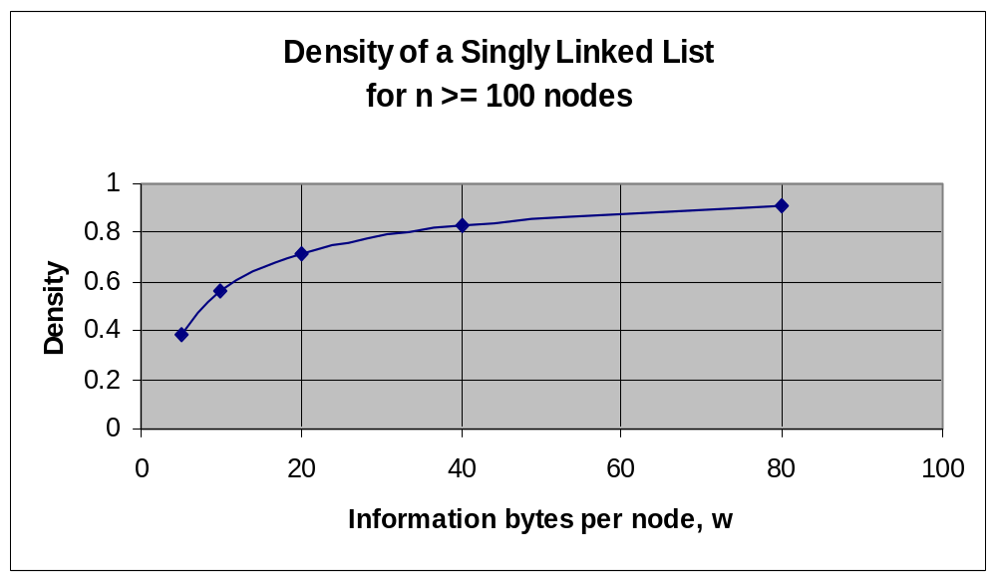
Variation In Density Of A Singly Linked List With Node Width

Slide 27
Comparison of a Singly Linked Structure’s Performance With Other Structures
Data Structure | Operation Speed (in memory accesses) |  |  |  |  |  |  | Condition for Density >0.8
 | Insert | Delete | Fetch | Update = Delete + Insert | Average[1] | Big-O Average | Average for n = 10⁷
Unsorted- Optimized Array | 3 | ≤ n | ≤ n | ≤ n +3 | (3n+6)/4 = 0.75n + 1.5 | O(n) | 0.75x10⁷ + 1.5 | w > 16
Stack and Queue | 5 | combined with fetch | 4.5 | not supported | 9.5/2 = 5 | O(1) | 5 | w > 16
Singly Linked List | 6 | 1.5n | 1.5n | 1.5n +6 | (4.5n+12)/4= 1.13n + 3 | O(n) | 1.13x10⁷ + 3 | w > 33
[1] Assumes all operations are equally probable and is therefore calculated as an arithmetic average of the four operation times.

Slide 28
Singly Linked List Implementation of a Stack
Two approaches
  Modify the singly linked list structure
    Rename the insert method push
    Eliminate the delete and update methods
    Modify the fetch method
      Change its name to pop, and eliminate its parameter
      Change its algorithm to always fetch-and-delete the first node in the structure
  Use a singly linked list structure and a client side “trick”

Slide 29
The Pop Algorithm For A
Singly Linked List Based Stack
l
next
Before pop (A, B, C, then D was pushed)
h
null
180
l
next
l
next
l
next
l
next
649
300
null
180
300
D
D’s info
C
C’s info
B
B’s info
A
A’s info
649
l
next
After D is popped (reference to it put in p)
h
180 300
2
l
next
l
next
l
next
l
next
1
649
300
null
p
180
300
649
popped listing
D
D’s info
C
C’s info
B
B’s info
A
A’s info
649

Slide 30
The Pop Algorithm Pseudocode For A
Singly Linked List Based Stack
if(h.next == null) // stack empty
return null
else
1. { p = h.next.l ;
2. h.next = h.next.next; // delete the node from the stack
return p; // a shallow copy
}
l
next
h
180 300
2
l
next
l
next
l
next
l
next
1
649
300
null
p
180
300
649
popped listing
D
D’s info
C
C’s info
B
B’s info
A
A’s info
649

Slide 31
Client-Side “Trick” That Makes a Singly Linked List Behave Like a Stack
Add a dummy key field to the client’s node definition class, e.g., extra
  The contents of this field would be the same for all client nodes, e.g., private String extra = “X”;
  The compareTo method would operate on this field, extra.compareTo(targetKey)
Client operations
  Push would be: insert(newNode); // inserts at front of list
  Pop would be: p = fetch(“X”); // returns first node
  delete(“X”); // deletes first node
No changes necessary to the singly linked structure

Slide 32
A “Trick” Stack After Nodes A, B, C, And Finally D have Been Pushed
l
next
h
200
null
180
200
l
next
l
next
l
next
l
next
649
300
20
54
973
5
332
null
180
300
54
5
X
D’s info
X
C’s info
X
B’s info
X
A’s info
649
20
973
332

Slide 33
Problems With the Trick Approach
On the client (application) side
  An additional field must be added to the node
  The application programmer must have knowledge of the trick
  The client’s code is not very readable
    To perform a push the client invokes insert
    To perform a pop, the client invoked fetch and then delete
  If the client neglects to invoke delete during a a pop operation, a peek is performed

Slide 34
An Improved Approach to the “Trick” Stack
A new data structure is written that contains a singly linked list
It has a push and pop method invoked by the client to store and fetch client objects
  Push allocates a two field (key and r) Listing object that is inserted into the linked list
    key is set to “X”, r references the client object
  Pop performs p = fetch(“X”); delete(“X”);
    return p.r;
Memory Model

Slide 35
Improved “Trick” Stack After Nodes A, B, C, And Finally D have Been Pushed
l
next
h
200
null
180
200
l
next
l
next
l
next
l
next
649
300
20
54
973
5
332
null
Linked Node objects
180
300
54
5
key
r
key
r
key
r
key
r
X
368
X
21
X
452
X
84
Listing objects
649
20
973
332
D
D’s info
C
C’s info
B
B’s info
A
A’s info
Client objects
368
21
452
84

Slide 36
Other Types Of Linked Lists
Singly linked variations
  Circular
    The last node references the dummy node
  Double-Ended
    A reference variable references the last node
  Sorted
    Nodes are stored in key field sorted order
Doubly Linked list
  Each node has a 2nd link field to reference predecessor
Multilinked list
  Allow more than one traversal path through the nodes

Slide 37
Circular Singly Linked List
l
next
h
200
null
180
200
l
next
l
next
l
next
l
next
649
300
20
54
973
5
332
200
180
300
54
5
T’s key
info
X’s key
info
G’s key
info
B’s key
info
649
20
973
332
Algorithms

Slide 38
Circular Singly Linked List Algorithms
Same as the Singly Linked list algorithms except
  In the Initialization algorithm, the dummy node is made to reference itself
  h.next = h
  In the Fetch and Delete algorithms (Lines 2 and 3)
    The condition for “node found” is changed from
    p != null to p != h, i.e.
    while(p != h && targetKey != p.l.getKey) // search
      if(p != h) // node found

Slide 39
Double-Ended Singly Linked List
Insertions can be made at the end of the list
Advantage: Ideally suited for a linked implementation of a Queue
l
next
h
200
null
180
rear
5
200
l
next
l
next
l
next
l
next
649
300
20
54
973
5
332
null
180
300
54
5
T’s key
info
X’s key
info
G’s key
info
B’s key
info
649
20
973
332
Algorithms

Slide 40
Double-Ended Singly Linked List Algorithms
Initialization
  rear = null; // for an empty list
A method is added to insert nodes at the end of the list (to facilitate an enqueue operation)
if(rear == null) // empty list
{ rear = new Node(); // a linked list node
h.next = rear;
else
{ rear.next = new Node(); // a linked list node
rear = rear.next;
}
rear.l = deepCopy(newNode) // add the new information

Slide 41
Sorted Singly Linked list
Below graphic independent of node insertion order
Advantage: Output traversal outputs the node in sorted order
l
next
h
200
null
180
200
l
next
l
next
l
next
l
next
332
300
973
54
649
5
20
null
180
300
54
5
B’s key
info
G’s key
info
T’s key
info
X’s key
info
332
973
649
20
Algorithms

Slide 42
Sorted Singly Linked List Algorithms
Same as Singly Linked list except
  The Insert algorithm is modified
    Adds a sequential search to find insertion point
    Search continues until a node is found whose key is greater than the new node’s key, or the last node is found
  In the Delete algorithm
    The sequential search Boolean condition is expanded to halt when a node is found whose key is greater than the given key
    Halt on expanded condition means key not found

Slide 43
Doubly Linked List
A link field, back, added to each Node
Advantage: Permits backward traversal through the list
back
next
h
200
null
null
180
200
back
l
next
back
l
next
back
l
next
null
649
300
180
20
54
300
973
null
180
300
54
T’s key
info
X’s key
info
G’s key
info
649
20
973
Algorithms

Slide 44
Doubly Linked List Operation Algorithms
Fetch algorithm the same as the Singly Linked list
Initialize, Insert, and Delete algorithms modified to include the setting of the back link
  Initialize adds: h.back = null;
  Insert adds: h.next.back = n; // n is the new node
  after Line 2a
  Delete adds: if(p.next!= null) // not last node
  { p.next.back = p.back;}
  after Line 3 (p references the node to be deleted)
Density

Slide 45
Density of a Doubly Linked List
Density = information bytes / total bytes
  Information bytes = n * w
    n is the number of nodes, w is the bytes per node
  Overhead = 4(1 + 3 + 3n) bytes (for ref. variables)
    4 bytes per variable * (Header + dummy node + linked nodes)
Density = n * w / (n * w + 4(1 + 3 + 3n) )
= 1 / (1 + 16 / (n*w) + 12 / w)
  As n gets large above approaches 1 / (1 + 12 / w)

Slide 46
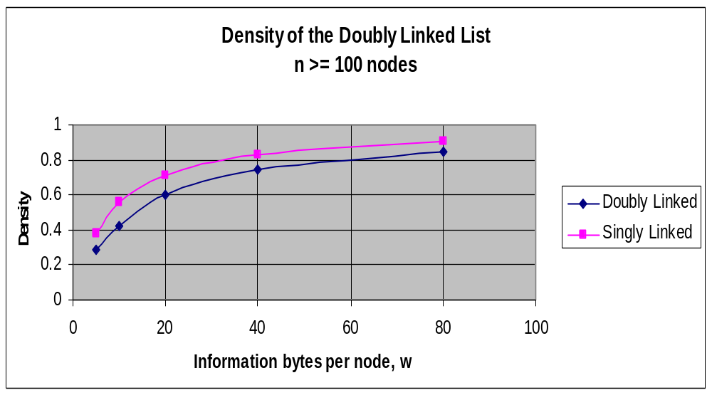
Variation In Density Of A Doubly Linked List With Node Width

Slide 47
Multilinked List Implemented As Two Singly Linked Lists
l
next
h1
200
null
180
200
the first singly linked list
l
next
l
next
l
next
l
next
332
300
973
54
649
5
20
null
180
300
54
5
the client’s information
B’s key
info
G’s key
info
T’s key
info
X’s key
info
332
973
649
20
l
next
l
next
l
next
l
next
649
621
332
32
973
256
20
null
the second singly linked list
452
621
32
256
l
next
h2
392
null
452
392

Slide 48
Iterators
Objects used to sequentially operate on nodes in a linear list
  e.g. Update 1st node, 2nd node, … update n^{th} node)
More efficient and practical than key field or node number modes for sequential node operations
  These modes perform a new sequential search through the list for each node accessed
  Iterators maintain their position in the list after a node is accessed
Typical client-side use: add an area code to every listing in a phone book data base
  Key field or node number modes: O(n*n); iterator: O(n)
Implemtations

Slide 49
Typical Iterator Operations
Iterator Method | Description
public void reset( ) | positions the iterator at the dummy node
public boolean hasNext() | returns true if there is a node after the iterators current position
public Listing next( ) | moves the iterator to the next node, and then returns a reference to its information, or a clone
public void set(Listing newListing) | replaces the information, stored at the iterator’s current position, with newListing. The iterator’s position is not changed.

Slide 50
An Example: Add an Area Code to All Entries in the Phonebook boston
// Assumes aListing can reference a linked Node in the list
String num;
SllIterator i1; // declares an iterator reference, i1
i1 = boston.iterator(); // attaches it to list boston
while ( i1.hasNext() ) // not at end of list
{ aListing = i1.next(); // move iterator one node
// and return the node’s location
num = aListing.getNumber();
num = “631” + num;
aListing.setNumber(num);
i1.set(aListing); // update the node at the
// current iterator position
}

Slide 51
Implementing an Iterator Class
Two techniques. The iterator class is defined
  Inside the data structure class (as an inner class)
    Maintains the data structure’s encapsulation
    Called and internal iterator
  Outside the data structure class
    Allows the client to specify the name (and number) of the iterator objects
    The iterator class can be used by multiple data structures
    Implementation unencapsulates the data structure
    Called an external iterator

Slide 52
Implementing An Internal Iterator
The iterator (inner) class
  Data members
    One linked list Node reference variable, ip
  Methods
    Constructor to set ip referencing the dummy node
    Operation methods: reset, next, hasNext, set,..
The data structure (outer) class
  Declares the iterator reference(s) with public access
  Creates the iterator object in its constructors
Client side use different than external iterators

Slide 53
Client Side Use Of An Internal Iterator To Operate On The Structure boston
// Assumes: aListing can reference a linked Node in the list
// The name of the iterator declared in the data
// structure is i
String num;
while (boston.i.hasNext() ) // not at end of list
{ aListing = boston.i.next(); // move iterator one node
// and return node’s location
num = aListing.getNumber();
num = “631” + num;
aListing.setNumber(num);
boston.i.set(aListing); // update the node at the
// current iterator position
}

Slide 54
Implementing an External Iterator
The iterator class (is no longer an inner class)
  Data members
    Two linked list Node reference variable, ip and h
  Methods
    A constructor that is passed the location of the dummy node and sets ip and h referencing it
    Operation methods: reset, next, hasNext, set,..
The data structure class
  Adds a method, iterator, to allocate an object in the iterator class and return a reference to it
The linked node definition class
  is no longer an inner class and its data members have package access
Client side use different than external iterators

Slide 55
The Iterator Class’ iterator method
Used by the client to attach external iterators to data structure objects
Assumes h is the data structure list header, and SllIterator is the name of the iterator class
public SllIterator iterator( )
{ SllIterator it = new SllIterator(h)
return ( it ) ;
}

Slide 56
Client Side Use Of An External Iterator To Operate On The Structure boston
// Assumes aListing can reference a linked list node
String num;
SllIterator i1; // declares an iterator reference
i1 = boston.iterator(); // attaches it to list boston
while ( i1.hasNext() ) // not at end of list
{ aListing = i1.next(); // move iterator one node
// and return node’s location
num = aListing.getNumber();
num = “631” + num;
aListing.setNumber(num);
i1.set(aListing); // update the node at the
// current iterator position
}

Slide 57
Java’s LinkedList and ListerIterator Classes
LinkedList class
  Is in the package java.util
  Is a double-ended, doubly linked list
  Is accessed in the node number mode, or using external (client declared) ListIterator objects
  Its methods allow for the four basic operations, and attaching a ListIterator class object
  Is an unencapsulated structure
Coding Example

Slide 58
Some Of The Methods In Java’s LinkedList Class
Basic operation | Method names | Example LinkedList myList = new LinkedList(); | Comments
Insert | add addLast addFirst | myList.add(5, bill); myList.addFirst(bill); myList.addLast(bill); | Inserts the object bill as the 5th, 1st , and last items respectively into the structure myList.
Fetch | get getFirst getLast | a = myList.get(5); b = myList.getFirst( ); c = myList.addLast( ); | Returns a shallow copy of the 5th, 1st , and last items respectively from the structure myList.
Delete | remove removeFirst removeLast | myList.remove(5); mylist.removeFirst( ); mylist.removeLast( ); | Deletes the 5th, 1st , and last items respectively, from the structure myList.
Update | set | myList.set(5, tom) | Updates the 5th item in the structure myList to the object tom.
Attach a ListIterator object | listIterator | ListIterator i = myList.listIterator() | Iterator i is positioned at the first item in the structure myList.

Slide 59
The ListIterator Class
Is in the package java.util
Implements an external iterator
  Client decides on the number of iterators
  Client names the iterator objects
Provides methods to operate on the structure it is attached to

Slide 60
Some Of The Methods In Java’s ListIterator Class
Basic operation | Method names | Example LinkedList d = new LinkedList() ListIteraor I =d.listIterator() | Comments
Insert | add | i.add(bill); | Inserts the object bill into the structure at the current iterator position and moves the iterator forward.
Fetch | next previous | a = i.next( ); b = i.previous( ); | Moves the iterator one position forward or backward (respectively) in the structure, and returns a shallow copy of the object at that position.
Delete | remove | i.remove( ); | Deletes the object at the current iterator position from the structure.
Update | set | i.set(tom); | Updates the item at the current iterator in the structure to the object tom.
Testing | hasNext hasPrevious | i.hasNext( ); i.hasPrevious( ); | Returns true if the iterator is not at the last or first objects (respectively) in the structure.

Slide 61
The Use Of The LinkedList and ListIterator Classes
import java.util.* // import LinkedList and listIterator
// declare two client phone Listing objets
Listing bill = new Listing("Bill", "1st Avenue", "123 4567");
Listing al = new Listing("Al", "2nd Avenue", "456 3232");
// declare a LinkedList data structure
LinkedList DataBase = new LinkedList();
// declare a ListIterator attached to the structure Database
ListIterator i = DataBase.listIterator();
// add two phone listings to the data set
i.add(bill);
i.add(al);

Slide 62


The End
Return to, Overview, Noncontiguous Structures, Linked lists, Singly Linked Lists, Other Types of linked lists, Iterators, Java’s LinkedList and ListIterator classes
End Presentation

